Slide 1

Probability and stats (Pt.1)
Basics of modeling and analyzing stock prices. Presented by: sam Wehner of kcail

Slide 2
What is the difference between probability and statistics?
What is probability?
Probability is the study of random variables.
What is statistics?
Statistics is the analysis of observations of random variables.
What is a random variable?
Let X represent the face-up side of a flipped coin. Then X is a random variable.
Random variables can be used in equations just like other, non-random, variables in algebra.

Slide 3

Probability: the mathematics of modeling
Let’s jump right into the problem of modeling stocks. We’ll start with a simplified model commonly known as a binomial tree.
Assumption: After each time step, stocks will be either up or down by a constant force of interest. We’ll get to that last bit later.
Let’s say B_{t} equals 1 if the stock price goes up and 0 if the stock price goes down at time t. Then B_{t} is a random variable. More specifically, B_{t} is what we call a Bernoulli random variable.

Slide 4
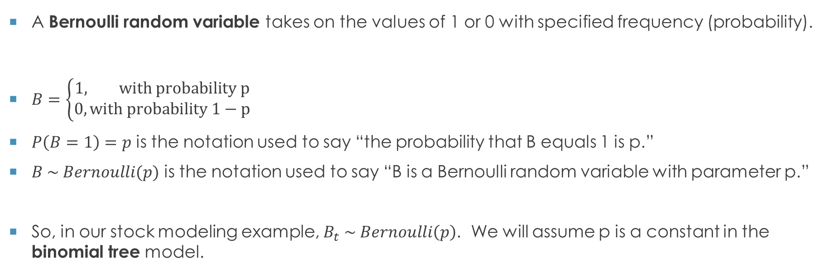
Bernoulli random variables
A Bernoulli random variable takes on the values of 1 or 0 with specified frequency (probability).
$B=\left\{\begin{aligned}1, with probability p \\ 0, with probability 1−p\end{aligned}\right.$
$P\left(B=1\right)=p$ is the notation used to say “the probability that B equals 1 is p.”
$B \sim Bernoulli(p)$ is the notation used to say “B is a Bernoulli random variable with parameter p.”
So, in our stock modeling example, $B_{t} \sim Bernoulli\left(p\right)$. We will assume p is a constant in the binomial tree model.

Slide 5
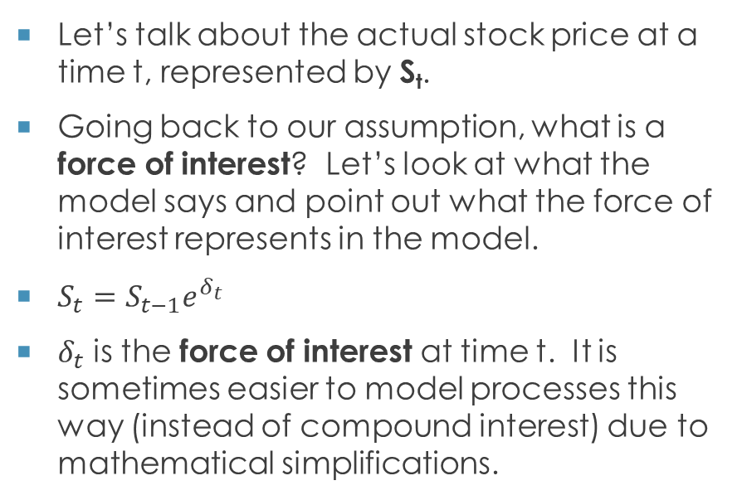
What is the force of interest?
Let’s talk about the actual stock price at a time t, represented by S_{t}.
Going back to our assumption, what is a force of interest? Let’s look at what the model says and point out what the force of interest represents in the model.
$S_{t}=S_{t−1}e^{δ_{t}}$
$δ_{t}$ is the force of interest at time t. It is sometimes easier to model processes this way (instead of compound interest) due to mathematical simplifications.

Slide 6
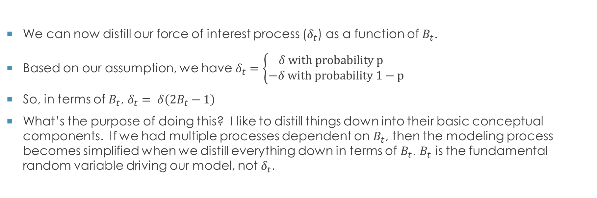
The force of interest as a function of a Bernoulli r.v.
We can now distill our force of interest process ($δ_{t}$) as a function of $B_{t}$.
Based on our assumption, we have $δ_{t}=\left\{\begin{aligned}δ with probability p \\ −δ with probability 1−p\end{aligned}\right.$
So, in terms of $B_{t}$, $δ_{t}= δ\left(2B_{t}−1\right)$
What’s the purpose of doing this? I like to distill things down into their basic conceptual components. If we had multiple processes dependent on $B_{t}$, then the modeling process becomes simplified when we distill everything down in terms of $B_{t}$. $B_{t}$ is the fundamental random variable driving our model, not $δ_{t}$.

Slide 7
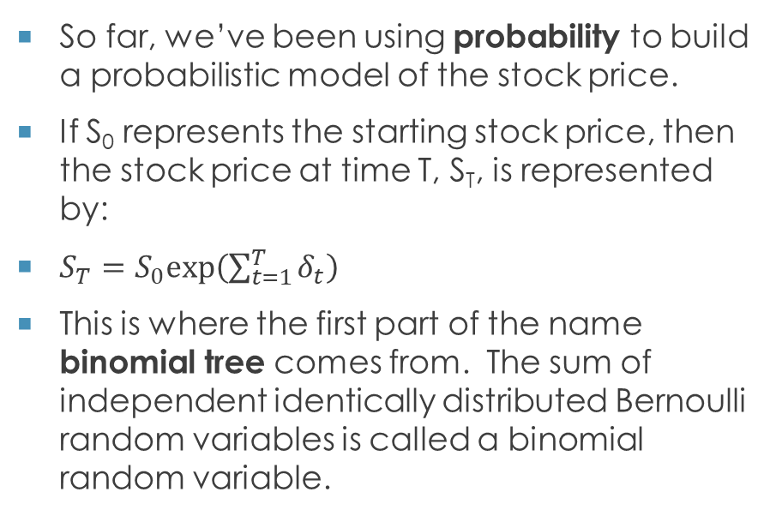
What have we been doing so far?
So far, we’ve been using probability to build a probabilistic model of the stock price.
If S₀ represents the starting stock price, then the stock price at time T, S_{T}, is represented by:
$S_{T}=S_{0}exp⁡\left(\sum_{t=1}^{T}{δ_{t}}\right)$
This is where the first part of the name binomial tree comes from. The sum of independent identically distributed Bernoulli random variables is called a binomial random variable.

Slide 8
independent and identically distributed… said no realist ever
This is a basic example to demonstrate the construction of a probabilistic model and perform statistics on it.
The fun part is to take what you learn here and replace the assumptions with more realistic ones.
HOWEVER, the binomial tree is the backbone of what is called the Black-Scholes model, which is widely used to calculate stock option prices on the exchanges. This is why if you think you know more about the underlying stock price process, you can try to more accurately price these instruments and buy or sell them at a higher chance of profit. And you would do so starting with the binomial tree and generalizing from there. Understanding how to construct the binomial tree model will enable you to build more realistic models.

Slide 9



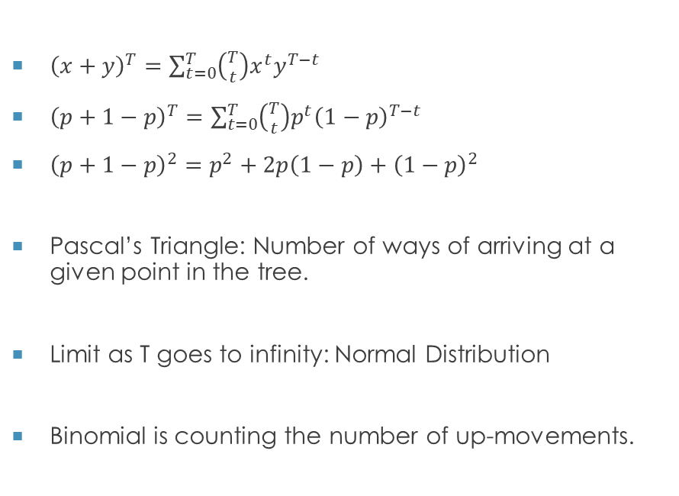






Visualizing the binomial tree
$$T=0$$
$$T=1$$
$$T=2$$
${\left(x+y\right)}^{T}=\sum_{t=0}^{T}{\left({T \atop t}\right)x^{t}y^{T−t}}$
${\left(p+1−p\right)}^{T}=\sum_{t=0}^{T}{\left({T \atop t}\right)p^{t}{\left(1−p\right)}^{T−t}}$
${\left(p+1−p\right)}^{2}=p^{2}+2p\left(1−p\right)+{\left(1−p\right)}^{2}$
Pascal’s Triangle: Number of ways of arriving at a given point in the tree.
Limit as T goes to infinity: Normal Distribution
Binomial is counting the number of up-movements.
$$p^{2}$$
$$p$$
$$1$$
$$2p\left(1−p\right)$$
$$1−p$$
$${\left(1−p\right)}^{2}$$

Slide 10
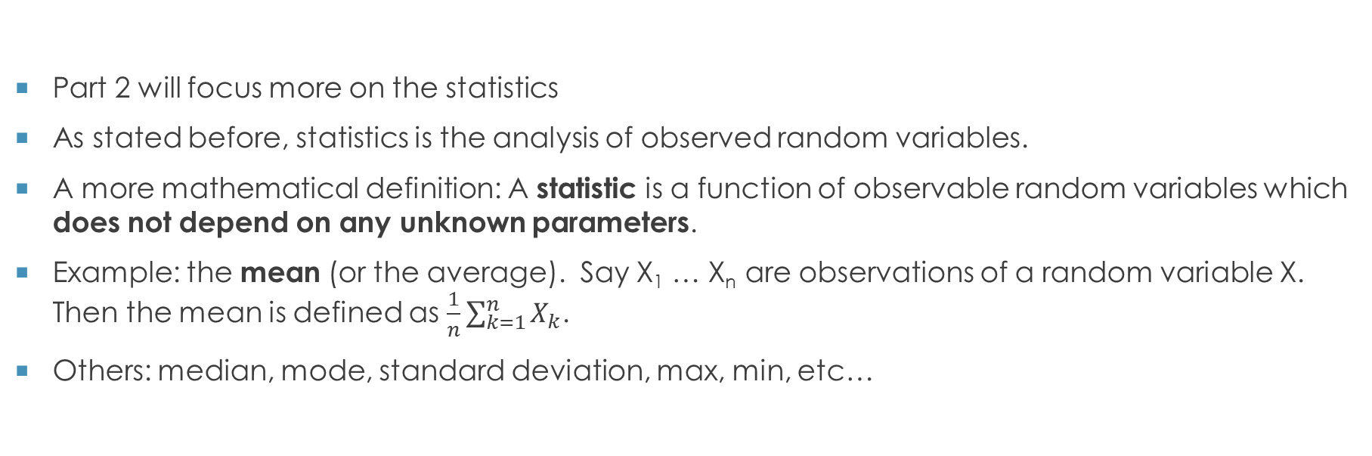
Brief introduction to statistics
Part 2 will focus more on the statistics
As stated before, statistics is the analysis of observed random variables.
A more mathematical definition: A statistic is a function of observable random variables which does not depend on any unknown parameters.
Example: the mean (or the average). Say X₁ … X_{n} are observations of a random variable X. Then the mean is defined as $\frac{1}{n}\sum_{k=1}^{n}{X_{k}}$.
Others: median, mode, standard deviation, max, min, etc…

Slide 11
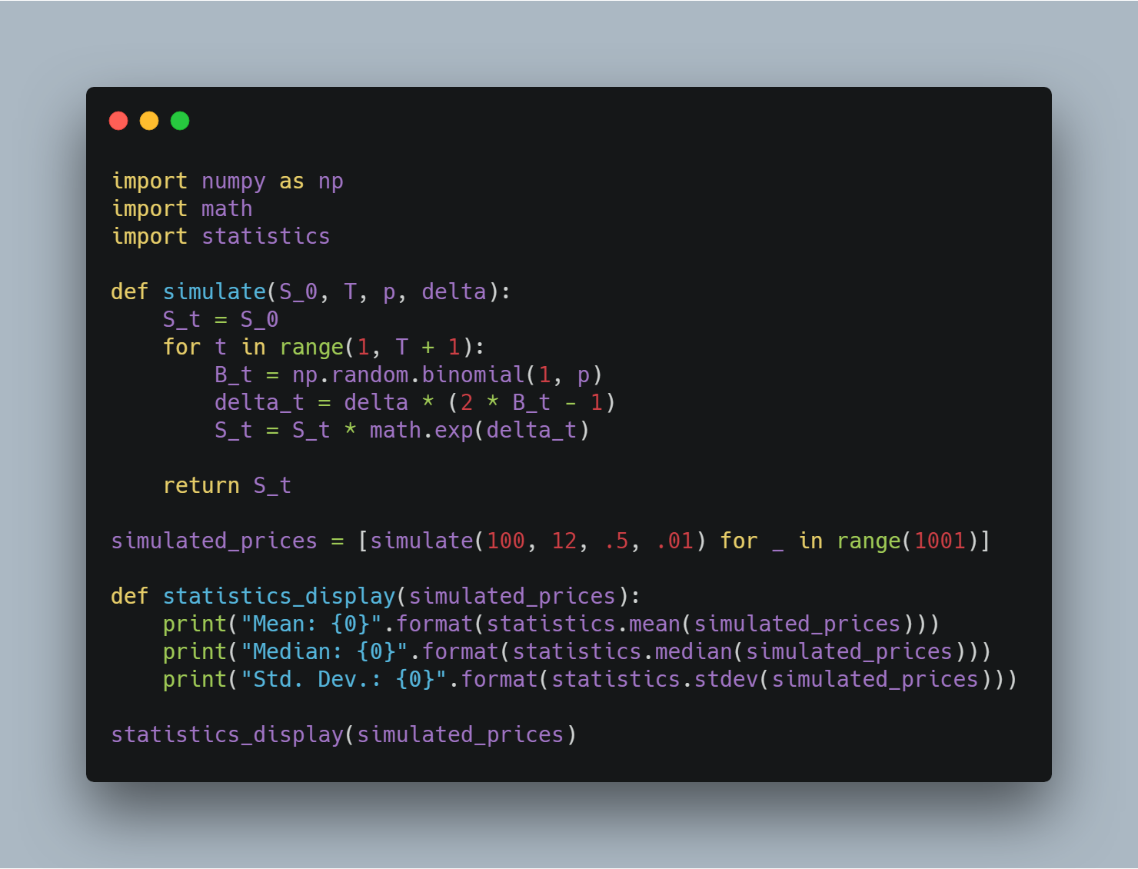

Simple simulation program

Slide 12

Q & a
Sam.Wehner@protonmail.com
Great book on Probability and stats:
Introduction to probability and mathematical statistics by bain & engelhardt

